Slide 1
Quiz on Lecture 9
Please receive the quiz handout from Cyrille, Oliver, Vincent, Jan
Complete the quiz in silence
Hand the quiz back

Slide 2
Quiz on Lecture 9
In one iteration of the outer loop in nested cross-validation, the inner loop is used to identify the best of two different hyperparameter combinations on the training data.
Assume the following inner-loop results using 2-fold cross-validation:
Fold 1 (train on chunk 1, test on chunk 2): for parameter combination A, accuracy = 0.62; for parameter combination B, accuracy = 0.65
Fold 2 (train on chunk 2, test on chunk 1): for parameter combination A, accuracy = 0.68; for parameter combination B, accuracy = 0.4
What immediately happens next in the process?
  combination A parameters are used in the next iteration of the outer-loop, to test the performance of the model on the test set
  combination B parameters are used in the next iteration of the outer-loop, to test the performance of the model on the test set
  combination A parameters are used to re-train the model using data from both chunks 1 & 2, and performance is tested on the unseen outer-loop test data
  combination B parameters are used to re-train the model using data from both chunks 1 & 2, and performance is tested on the unseen outer-loop test data.
An AI model, trained on 2010-2019 weather data to predict crop yield, becomes inaccurate by 2025. An investigation finds two reasons for the failure:
The statistical distributions of input features like rainfall and temperature have significantly shifted due to climate change.
Farmers now use a new crop variant that responds differently to heat, altering the established relationship between temperature and yield.
Given these findings, how would you classify the problem affecting the model?
  It is Data Drift, because the statistical properties of the input features have changed
  It is Concept Drift, because the fundamental relationship between an input feature and the target outcome has changed
  The problem is primarily Concept Drift, with the changing weather patterns being a secondary consequence
  None of the above
Which of the following is the best-defined business objective for an ML project?
  Build a churn prediction model with 99% accuracy.
  Improve customer satisfaction.
  Develop a model to predict customer churn to reduce the monthly churn rate by 15% in the next six months.
  Use machine learning to increase sales.
What is the primary advantage of using k-Fold Cross-Validation instead of a simple Train/Test Split?
  It eliminates the need for hyperparameter tuning.
  It only works for classification problems, not regression.
  It is computationally less expensive and faster to execute.
  It provides a more robust evaluation of the model's performance by using the entire dataset for both training and testing.
What is 'Concept Drift' in the context of model monitoring?
  The input data's statistical properties have changed over time.
  The model's performance metrics, like accuracy, have gradually decreased.
  The system's latency has increased, and it is serving predictions slower.
  The relationship between the input features and the target variable has changed.

Slide 3
Quiz on Lecture 9 (Answers)
In one iteration of the outer loop in nested cross-validation, the inner loop is used to identify the best of two different hyperparameter combinations on the training data.
Assume the following inner-loop results using 2-fold cross-validation:
Fold 1 (train on chunk 1, test on chunk 2): for parameter combination A, accuracy = 0.62; for parameter combination B, accuracy = 0.65
Fold 2 (train on chunk 2, test on chunk 1): for parameter combination A, accuracy = 0.68; for parameter combination B, accuracy = 0.4
What immediately happens next in the process?
  combination A parameters are used in the next iteration of the outer-loop, to test the performance of the model on the test set
  combination B parameters are used in the next iteration of the outer-loop, to test the performance of the model on the test set
  combination A parameters are used to re-train the model using data from both chunks 1 & 2, and performance is tested on the unseen outer-loop test data
  combination B parameters are used to re-train the model using data from both chunks 1 & 2, and performance is tested on the unseen outer-loop test data.
An AI model, trained on 2010-2019 weather data to predict crop yield, becomes inaccurate by 2025. An investigation finds two reasons for the failure:
The statistical distributions of input features like rainfall and temperature have significantly shifted due to climate change.
Farmers now use a new crop variant that responds differently to heat, altering the established relationship between temperature and yield.
Given these findings, how would you classify the problem affecting the model?
  It is Data Drift, because the statistical properties of the input features have changed
  It is Concept Drift, because the fundamental relationship between an input feature and the target outcome has changed
  The problem is primarily Concept Drift, with the changing weather patterns being a secondary consequence
  None of the above
Which of the following is the best-defined business objective for an ML project?
  Build a churn prediction model with 99% accuracy.
  Improve customer satisfaction.
  Develop a model to predict customer churn to reduce the monthly churn rate by 15% in the next six months.
  Use machine learning to increase sales.
What is the primary advantage of using k-Fold Cross-Validation instead of a simple Train/Test Split?
  It eliminates the need for hyperparameter tuning.
  It only works for classification problems, not regression.
  It is computationally less expensive and faster to execute.
  It provides a more robust evaluation of the model's performance by using the entire dataset for both training and testing.
What is 'Concept Drift' in the context of model monitoring?
  The input data's statistical properties have changed over time.
  The model's performance metrics, like accuracy, have gradually decreased.
  The system's latency has increased, and it is serving predictions slower.
  The relationship between the input features and the target variable has changed.

Slide 4
Designing and Deploying
end-to-end
Production Grade ML Applications
Lecture 10: Automation using MLflow
October 2025
Cyrille Feudjio & Oliver Angélil

Slide 5
Contents of this lecture
Challenges in Traditional Machine Learning
From Experimentation to Deployment
Introducing MLflow
Managing the ML Lifecycle with MLflow
  Experimentation & Tracking
  Model Packaging
  Model Registration
  Model Serving & Inference
Putting It All Together
Conclusion & Q&A

Slide 6
1. Challenges in Traditional Machine Learning
Let’s first see the challenges data scientists face with the old way of working
Let's suppose Mr SIMI is a data scientist at a telecom company. SIMI's task is to build a model that predicts which customers are likely to churn (cancel their subscription). Below is SIMI Traditional Workflow:
Local Development: Works in a Jupyter Notebook on a local laptop
Manual Experimentation: Tries different algorithms (Logistic Regression, Random Forest) and manually tunes hyperparameters
Tracking: Keeps track of results in spreadsheets. The model files are saved locally in a folder with names like churn_model_v1.pkl, churn_model_v2_better.pkl
After finding a good model (final_churn_model.pkl), he emails it to the engineering team for deployment
This common approach seems straightforward right? but it quickly leads to significant problems

Slide 7
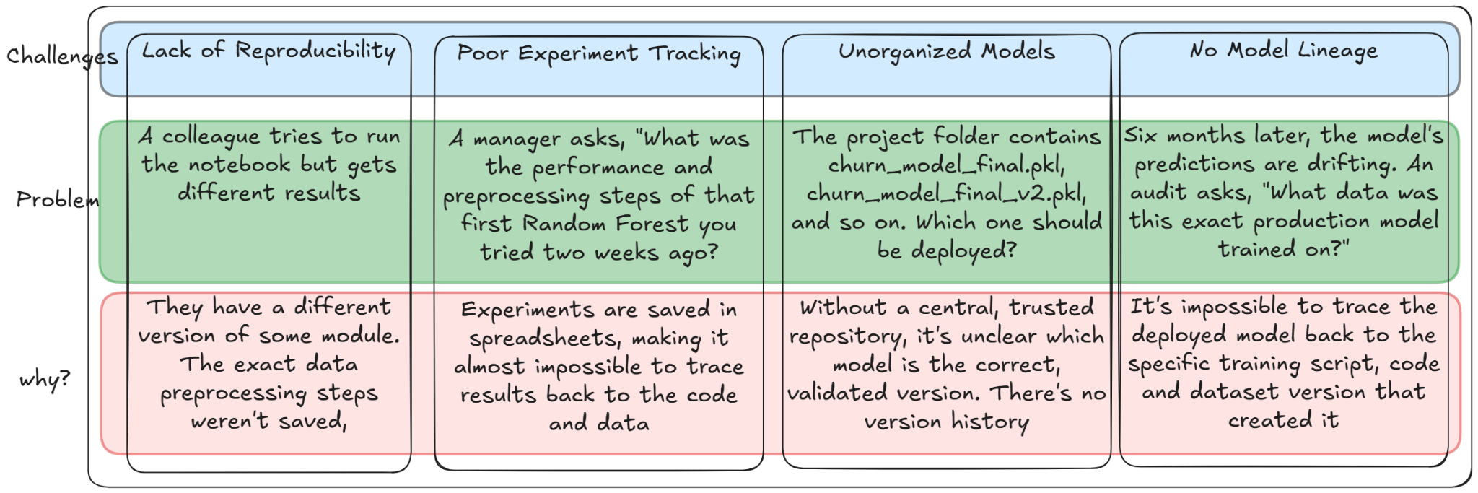
1. Challenges in Traditional Machine Learning

Slide 8
2. From Experimentation to Deployment
A typical machine learning project follows a lifecycle:
Experimentation & Tracking: Train various models and track their performance.
Model Packaging: Save the trained model in a standard format.
Model Registration: Version and manage the best models in a central repository.
Model Serving & Inference: Deploy the model and use it to make predictions.
We will now introduce the tool that will help us manage this entire lifecycle: MLflow.

Slide 9
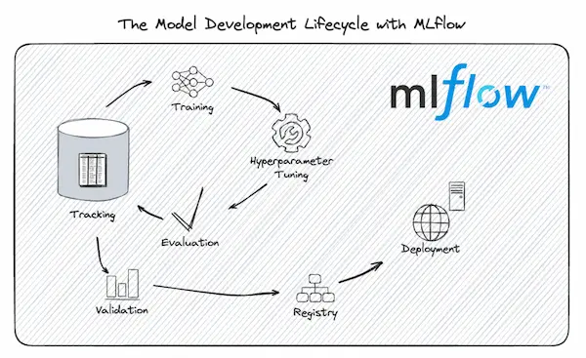
3. Introducing MLflow
MLflow is an open-source platform for managing the end-to-end machine learning lifecycle.
Before we dive into the components, it's important to understand the philosophy that makes MLflow so powerful and flexible

Slide 10
3. Introducing MLflow
3.1 MLflow's Philosophy
MLflow is designed with a few core principles in mind, as stated in its documentation:
Open Source
Works with any ML library, language & cloud: MLflow is not tied to any specific framework.
Modular: You can use each component (Tracking, Models, Registry) on its own. You don't have to adopt the entire platform at once.
Scalable: Designed to scale from a single user on a laptop to large teams in an enterprise environment.

Slide 11
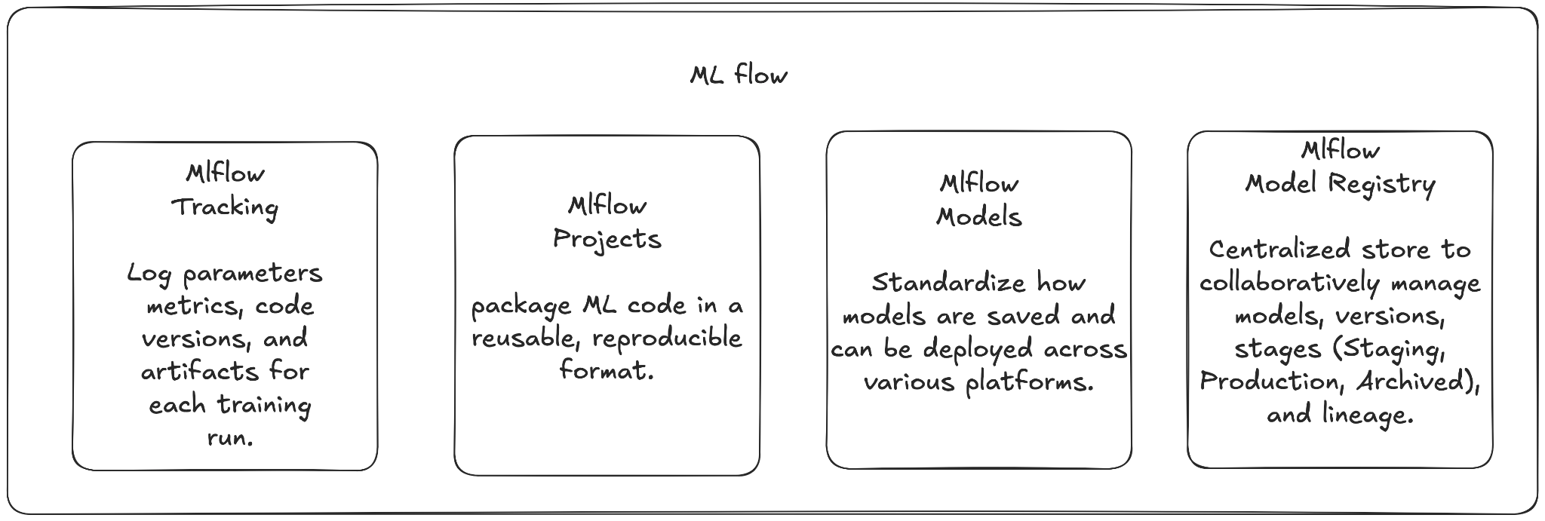
3. Introducing MLflow
3.2 MLflow's Core Components
With that foundation, let's begin our journey through the ML lifecycle, starting with the first and most critical step: tracking our experiments

Slide 12
4. Managing the ML Lifecycle with MLflow
4.1 Experimentation & Tracking
Here we use the component called MLflow Tracking. It is an API and UI for logging parameters, code versions, metrics, and artifacts when running your machine learning code.
Why we need it: To solve the problem of poor experiment tracking and lack of reproducibility. With MLflow Tracking, you have a centralized place to record and compare all your experiments.

Slide 13
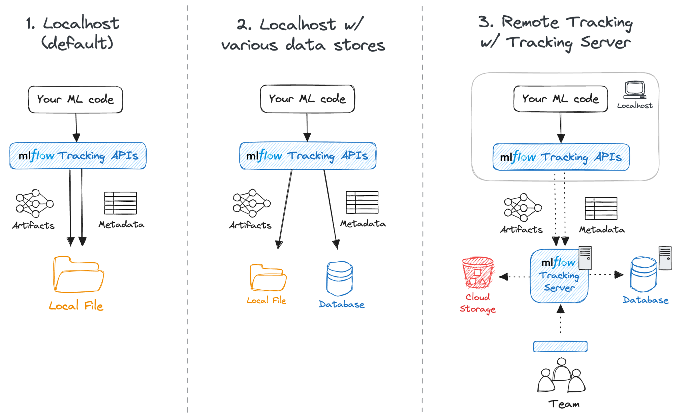
4. Managing the ML Lifecycle with MLflow
4.1.1 Tracking Strategy
source
Let's see how this looks in practice with a code example

Slide 14
4. Managing the ML Lifecycle with MLflow
4.1.1 Tracking Strategy
BASE_DIR = os.path.abspath(os.getenv("DAGSTER_HOME", ".")) # base directory for all MLflow data.
SQLITE_DB_FILENAME = "mlflow_local_tracking.db" # Name of the SQLite database file
# Construct full paths
SQLITE_DB_PATH = os.path.join(BASE_DIR, SQLITE_DB_FILENAME)
DEFAULT_EXPERIMENT_NAME = "era5_temperature_analysis"
# Define the MLflow resource
mlflow_resource = mlflow_tracking.configured(
{
# Point MLflow to use the local SQLite database
"mlflow_tracking_uri": f"sqlite:///{SQLITE_DB_PATH}",
"experiment_name": DEFAULT_EXPERIMENT_NAME,
}
)
The MLflow Models tab requires a tracking database to store model registry information. Without a DB, only experiment tracking is available, not model management

Slide 15
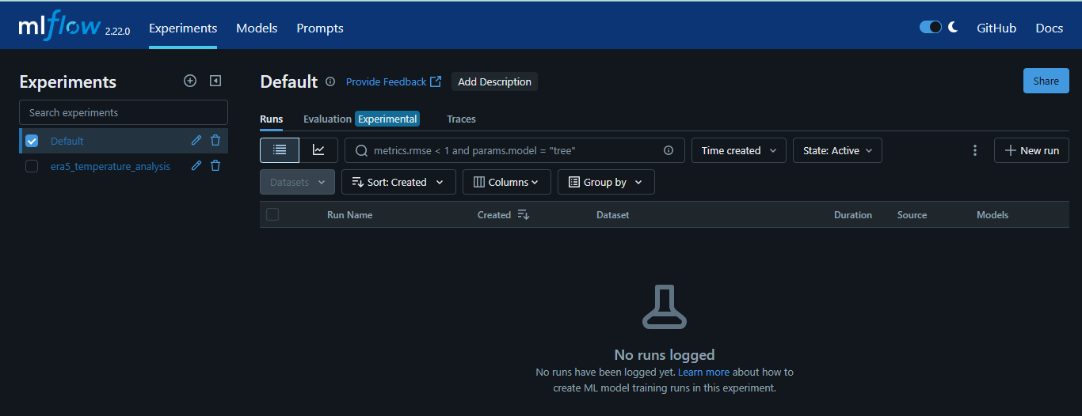
4. Managing the ML Lifecycle with MLflow
4.1.1 Tracking Strategy

Slide 16
4. Managing the ML Lifecycle with MLflow
4.1.2 Tracking Code Example
predictions = model.predict(X_test)
mse = mean_squared_error(y_test, predictions)
mae = mean_absolute_error(y_test, predictions)
r2 = r2_score(y_test, predictions)
context.log.info(f"Final Model Evaluation Metrics on Test Set: MSE={mse:.4f}, MAE={mae:.4f}, R2={r2:.4f}")
eval_metrics = {"test_mse": mse, "test_mae": mae, "test_r2": r2}
# call mlflow tracking API client to log model evaluation metrics
mlflow_client.log_metrics(eval_metrics)

Slide 17
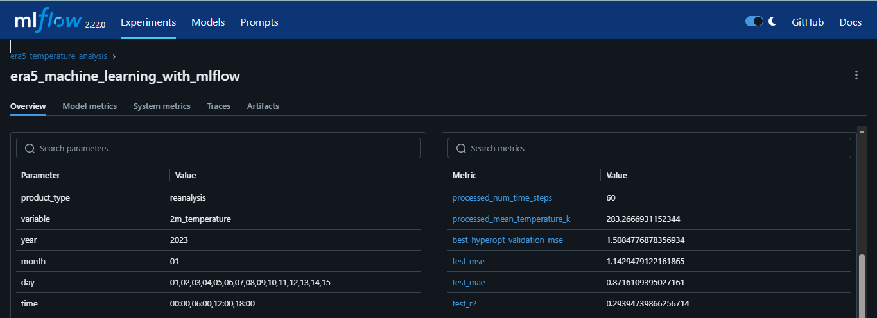
4. Managing the ML Lifecycle with MLflow
4.1.2 Tracking Code Example
NB: While manual logging gives you full control, MLflow offers an even simpler way to get started.

Slide 18
4. Managing the ML Lifecycle with MLflow
4.1.3 Automatic Experiment Tracking
For many popular libraries (Scikit-learn, TensorFlow, PyTorch, etc.), MLflow can automatically log everything for you with a single line of code: mlflow.autolog()
import mlflow
from sklearn.model_selection import train_test_split
from sklearn.datasets import load_diabetes
from sklearn.ensemble import RandomForestRegressor
mlflow.autolog()
db = load_diabetes()
X_train, X_test, y_train, y_test = train_test_split(db.data, db.target)
rf = RandomForestRegressor(n_estimators=100, max_depth=6, max_features=3)
# MLflow triggers logging automatically upon model fitting
rf.fit(X_train, y_train)

Slide 19
4. Managing the ML Lifecycle with MLflow
4.1.3 Automatic Experiment Tracking
You usually should not rely on mlflow.autolog() directly in production code, and here’s why:
It logs everything by default, which may include unnecessary artifacts, making runs noisy and storage heavy
The process is hidden, so you don’t see exactly when or how things are being logged. If your production pipeline breaks or behaves unexpectedly, debugging can be harder.
Once our runs are logged, we need a way to see and compare them. That's where the UI comes in

Slide 20
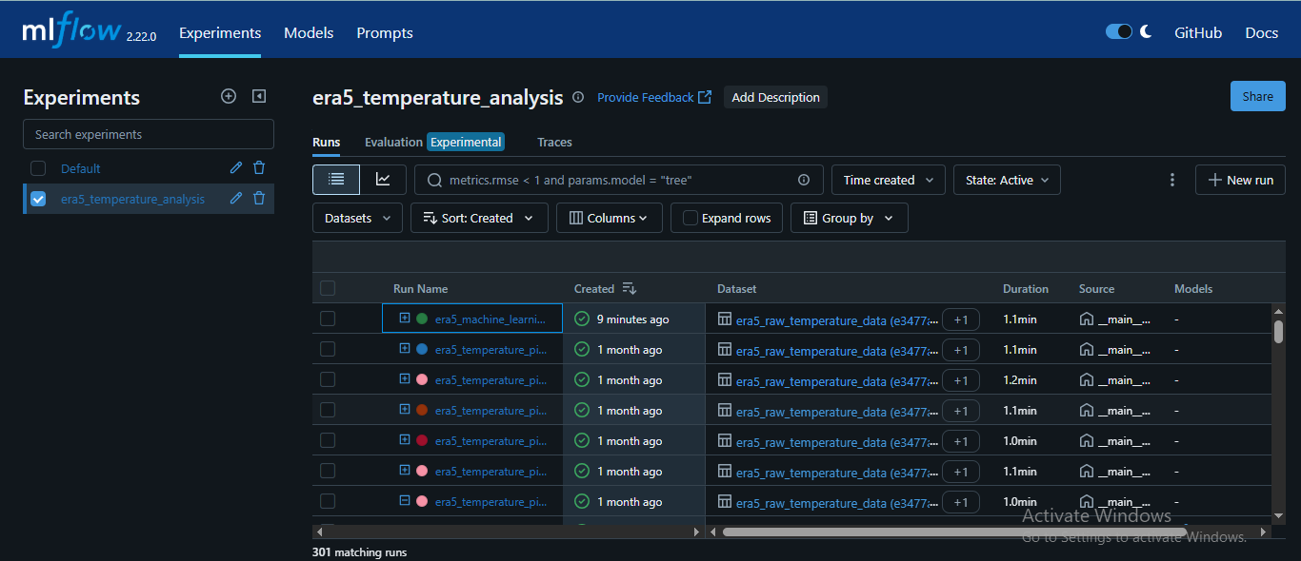
4. Managing the ML Lifecycle with MLflow
4.1.4 Visualizing and Comparing Experiments
The MLflow Tracking UI provides a web-based interface to visualize, search, and compare your runs, helping you quickly identify the best-performing models.
Beyond the UI, MLflow also provides a way (the MlflowClient API) to interact with your tracking data programmatically, which is key for automation

Slide 21
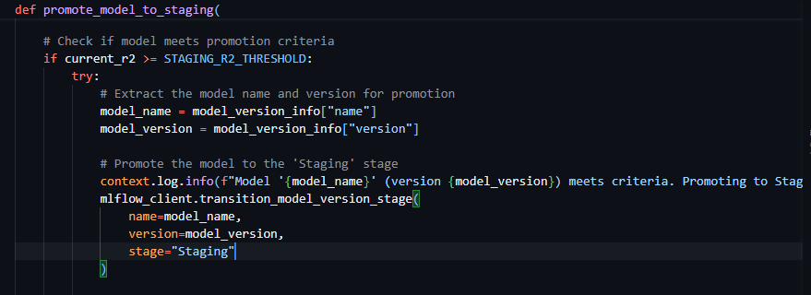
4. Managing the ML Lifecycle with MLflow
4.1.5 the MlflowClient API
In addition to logging, you can also use the MlflowClient API to interact with your experiments and runs programmatically.
The transition can also be done from the UI (we will see in the next few slides)

Slide 22
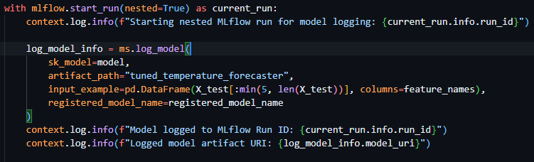
4. Managing the ML Lifecycle with MLflow
4.2 Model Packaging
Here we use MLflow Models. it provide a standard format for packaging machine learning models.
Why we need it: To solve deployment difficulties. With MLflow Models, you package your model in a way that can be easily deployed to a variety of environments.
How it works: When you call mlflow.log_model(model, "model"), MLflow saves the model in a directory with a standard structure, including the serialized model and its dependencies.
Let's see where we can find this packaged model and its metadata in the MLflow UI.

Slide 23
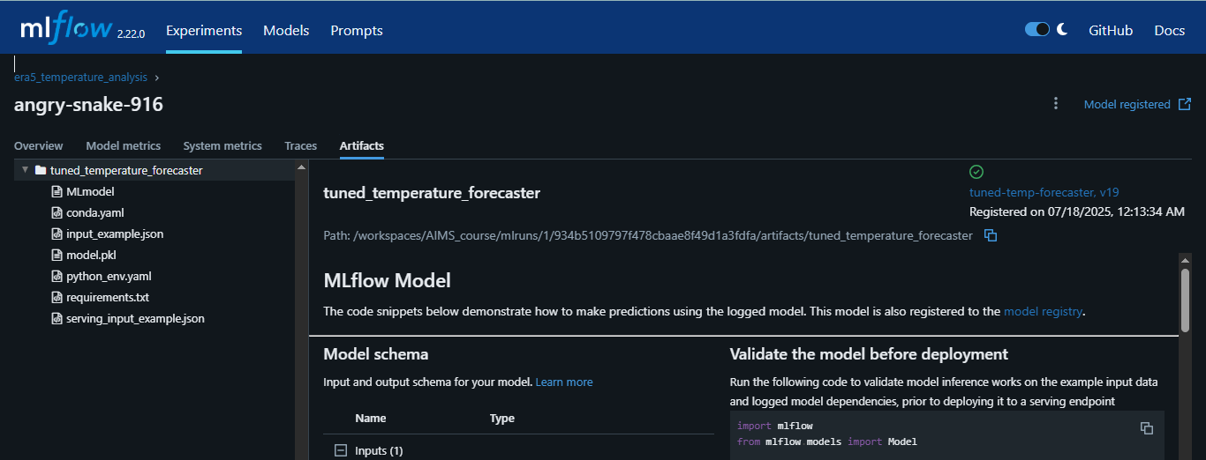
4. Managing the ML Lifecycle with MLflow
4.2.1 The Artifacts View
In the MLflow UI, you can navigate to a run's "Artifacts" section to see the logged model files. This directory is your self-contained, deployable model package. You'll see the ML model file

Slide 24
4. Managing the ML Lifecycle with MLflow
4.3 Model Registration

Slide 25
4. Managing the ML Lifecycle with MLflow
4.3 Model Registration
Here we use a component called Model Registry. It is a centralized model store, API, and UI to collaboratively manage the full lifecycle of an MLflow Model.
Why we need it: To solve the "unorganized" model problem and provide a structured, auditable way to manage the model lifecycle from development to production.
You can register a model directly when you log it, or after a run is complete
Option 1: Log and register in one step
with mlflow.start_run(nested=True) as current_run:
log_model_info = ms.log_model(
sk_model=model,
artifact_path="tuned_temperature_forecaster",
input_example=pd.DataFrame(X_test[:min(5, len(X_test))], columns=feature_names),
registered_model_name=registered_model_name
)
Option 2: Register an existing model from a run
result = mlflow.register_model(
"runs:/d16076a3ec534311817565e6527539c0/model",
"registered_model_name"
)

Slide 26
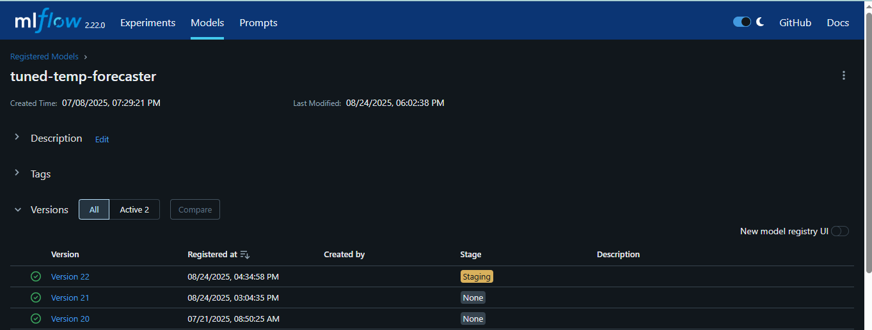
4. Managing the ML Lifecycle with MLflow
4.3.1 The Model Registry UI
The Model Registry UI provides a central place to view and manage all your registered models, their versions, and their current stage.

Slide 27
4. Managing the ML Lifecycle with MLflow
4.3.2 Stages transition
The Model Registry allows you to manage the lifecycle of your models:
Versioning: Automatically creates a new version for each newly registered model.
Annotations: Add descriptions and tags to your models for better organization
Stage Transitions: Move model versions between stages like None, Staging, Production, and Archived. These stage transitions can be done manually in the UI or automated through code
Explanation:
None: Default initial stage
Staging: Version is under testing/validation
Production: Version is currently deployed and serving traffic
Archived: Version is no longer in use

Slide 28
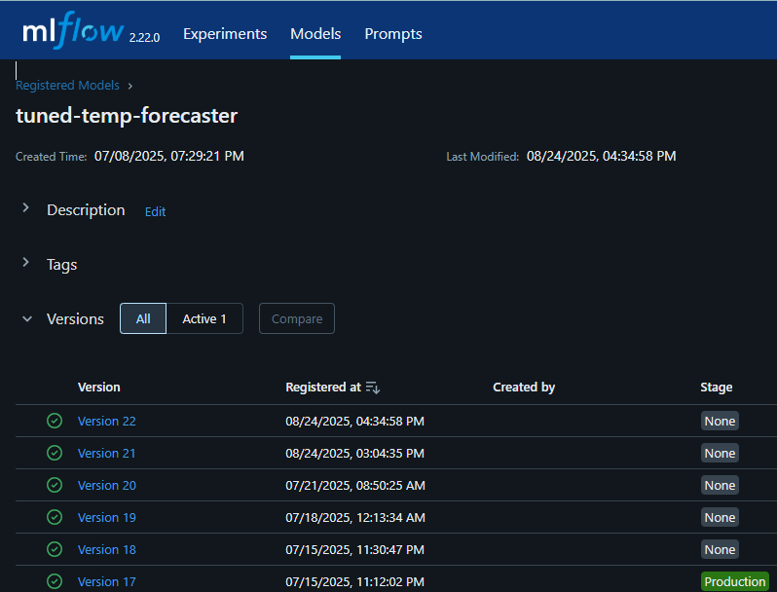
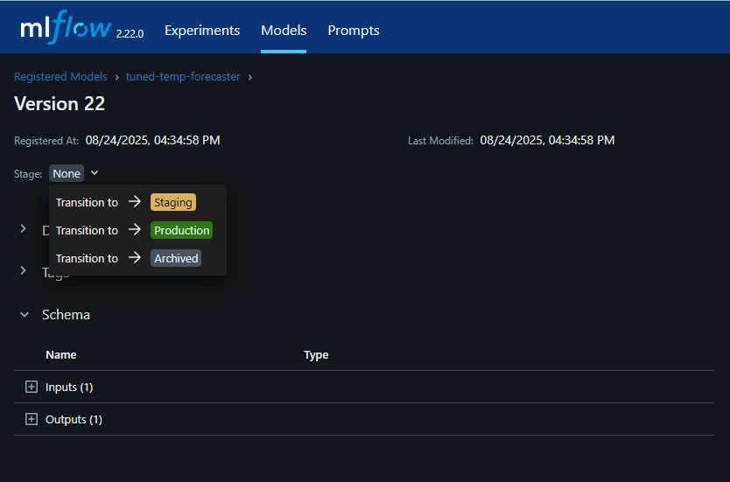
4. Managing the ML Lifecycle with MLflow
4.3.2 Stages transition
The Model Registry allows you to manage the lifecycle of your models:
With our model now managed and promoted, we're ready for the final step: putting it to use.

Slide 29
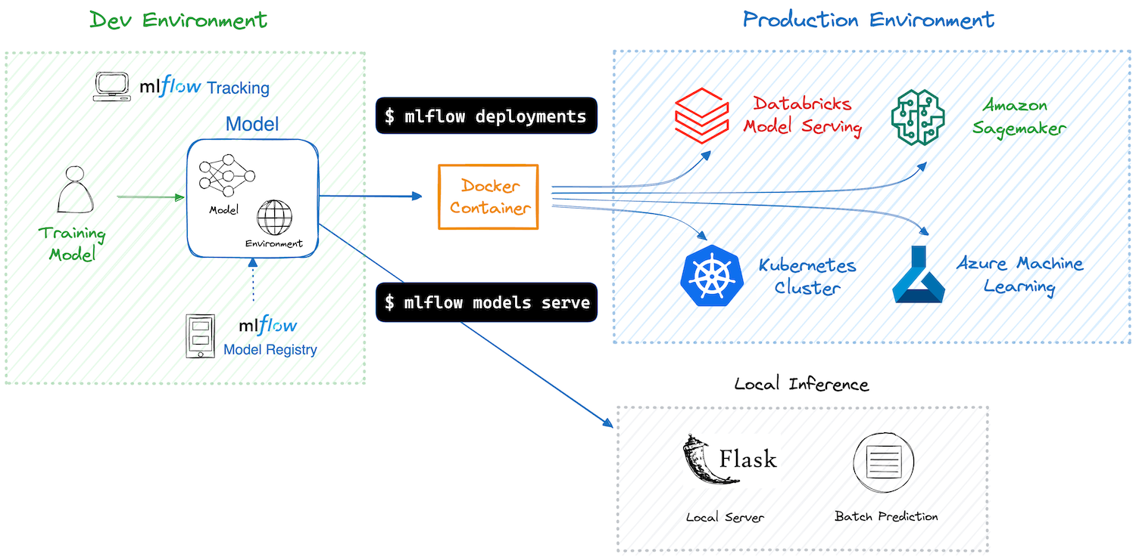
4. Managing the ML Lifecycle with MLflow
4.4 Model Serving & Inference
After training your machine learning model and confirming it works well, the next step is to deploy it. Deployment can be tricky, but MLflow makes it easier by providing tools to deploy models to local setups or cloud services.
source

Slide 30
4. Managing the ML Lifecycle with MLflow
4.4.1 Using a Model from the Registry
import os
import mlflow
import pandas as pd
MODEL_NAME = "tuned-temp-forecaster"
MODEL_STAGE = "Production"
# Construct an absolute path to the database file.
SCRIPT_DIR = os.path.dirname(os.path.abspath(__file__))
DB_PATH = os.path.join(SCRIPT_DIR, "..", "..", "..", "..", "..", "mlflow_local_tracking.db")
# Construct the URI to load the model from the registry
model_uri = f"models:/{MODEL_NAME}/{MODEL_STAGE}"
# Set up MLflow Tracking
mlflow.set_tracking_uri(f"sqlite:///{os.path.abspath(DB_PATH)}")

Slide 31
4. Managing the ML Lifecycle with MLflow
4.4.1 Using a Model from the Registry
# Prepare Input Data
input_data = pd.DataFrame(
data={
"t2m_celsius_lag1": [5.0, 10.0, 15.5, 20.2]
}
)
# Run Prediction
results = mlflow.models.predict(
model_uri=model_uri,
input_data=input_data,
env_manager="local",
)

Slide 32
4. Managing the ML Lifecycle with MLflow
4.4.2 Serving Your Model
MLflow provides simple, built-in commands to serve your model for testing or simple use cases. This command starts a local server that listens on the specified port and serves your model.
#!/bin/bash
# This script serves the production-ready ML model using the MLflow model server
set -e # Stop the script if any command fails
# Model and environment details
MODEL_NAME="tuned-temp-forecaster"
MODEL_STAGE="Production"
MLFLOW_PORT=5002
# Construct the path to the database
DB_PATH="/workspaces/AIMS_course/mlflow_local_tracking.db"
# Set the MLFLOW_TRACKING_URI for the mlflow command
export MLFLOW_TRACKING_URI="sqlite:///$DB_PATH"
# The --env-manager=local flag tells MLflow to use the current virtual environment
mlflow models serve -m "models:/$MODEL_NAME/$MODEL_STAGE" --port "$MLFLOW_PORT" --env-manager=local

Slide 33
4. Managing the ML Lifecycle with MLflow
4.4.2 Serving Your Model
Here is how you can test your deployed model. Open a new terminal and run the following command
curl -X POST -H "Content-Type:application/json" --data '{"dataframe_split": {"columns": ["t2m_celsius_lag1"], "data": [[12.5]]}}' http://127.0.0.1:5002/invocations
Let's break down that command so it's clear what's happening:
curl -X POST: This tells curl to send a POST request, which is standard for submitting data to an API.
-H "Content-Type:application/json": This header tells the server that you are sending data in JSON format.
--data '...': This is the actual data payload. MLflow's server expects this specific dataframe_split format for scikit-learn models:
  "columns": ["t2m_celsius_lag1"]: This specifies the feature name the model was trained on
  "data": [[12.5]]: This is a sample input value for the lagged temperature.
http://127.0.0.1:5002/invocations: This is the full URL to the prediction endpoint on the server you just started

Slide 34
4. Managing the ML Lifecycle with MLflow
4.4.2 Serving Your Model as a gradio app
import os
import gradio as gr
import mlflow
import pandas as pd
# Configuration
MODEL_NAME = "tuned-temp-forecaster"
MODEL_STAGE = "Production"
# Construct an absolute path to the database file.
DB_PATH="/workspaces/AIMS_course/mlflow_local_tracking.db"
# Set the tracking URI to find the local MLflow database
mlflow.set_tracking_uri(f"sqlite:///{os.path.abspath(DB_PATH)}")
# Construct the model URI for the registry
model_uri = f"models:/{MODEL_NAME}/{MODEL_STAGE}"
full code here

Slide 35
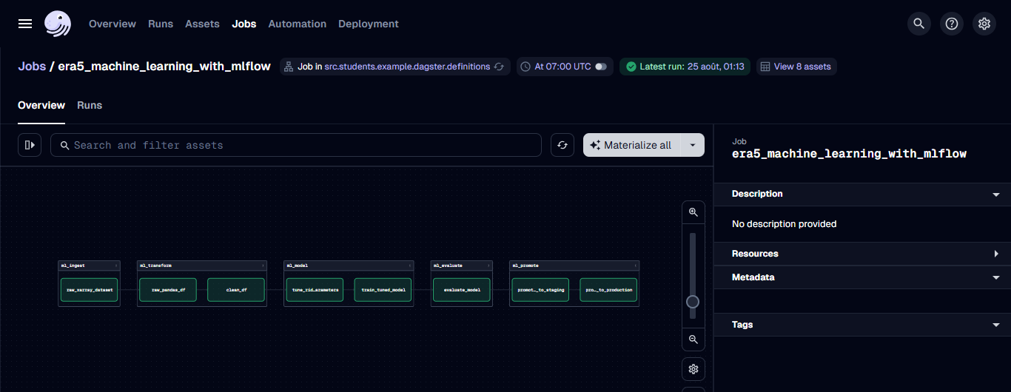
5. Putting It All Together
You can use an orchestrator like dagster to automate this entire end-to-end workflow. Check the full code from our repo

Slide 36
14. Conclusion & Key Takeaways
MLflow provides a comprehensive, open-source platform for managing the end-to-end machine learning lifecycle
By using MLflow with an orchestrator like Dagster, you can automate your ML workflows and accelerate the delivery of high-quality machine learning models

Slide 37
Q&A
"Questions?"

